Slide 1

SCHOOL OF COMPUTING
DEPARTMENT OF COMPUTER SCIENCE & ENGINEERING
WINTER SEMESTER 2025-2026
10214CS701 MAJOR PROJECT
“Meeting Summarizer: AI Tool that Converts
Meeting Trasnscripts into Action Plans”
REVIEW
SUPERVISED BY
Dr. D. Dhinakaran ; Associate Professor
PRESENTED BY
1. K VEERESH (VTU22009)(22UECS0360)
2. E NANDU ROYAL (VTU22201)(22UECS0188)

Slide 2
CONTENT
Introduction & Problem Statement
Project Goals & Objectives
Literature Review & Background
Proposed System Architecture
Methodology & Implementation Plan
Technology Stack & Tools
Expected Outcomes & Deliverables
Publication Status
Progress & Milestones Achieved (For Review-1)
Future Work & Next Steps
References

Slide 3
Introduction & Problem Statement
Introduction:
The rise of virtual work has increased meetings and unstructured data, making it hard to recall decisions and action items. Existing tools provide only transcripts or basic summaries, lacking structured action plans, ownership, and deadlines. Meeting Summarizer solves this through an AI-driven system that converts transcripts into actionable plans using speech-to-text and NLP to identify decisions, extract tasks, assign owners, and detect deadlines. With multilingual support, real-time analysis, and a modular architecture, it reduces cognitive load and improves accountability and efficiency.
Problem Statement:
"Meetings generate unstructured conversations where critical decisions and action items are lost, and existing tools provide only transcripts or basic summaries without structured action plans, accountability, or deadlines—leading to missed tasks, miscommunication, and reduced productivity."

Slide 4
Project Goals & Objectives
Overall Goal:
To develop an AI-powered Meeting Summarizer that transforms unstructured meeting transcripts into structured, actionable plans with clear task ownership and deadlines.
Specific Objectives:
Integrate speech-to-text + NLP + transformer models to identify discussions, decisions, and action items
Automatically extract tasks, assign owners, and detect deadlines from contextual cues
Support multilingual meetings with real-time and post-meeting analysis
Ensure privacy through modular, configurable architecture
Reduce cognitive load and improve accountability & efficiency

Slide 5
Literature Review & Background
Existing Solutions: Current meeting assistance tools fall into three categories. Transcript-based systems like Otter.ai and conferencing platforms generate verbatim transcripts with speaker labels. Summarization tools employ extractive or abstractive methods using transformer models to produce meeting digests. Advanced research prototypes use machine learning for dialogue act classification and intent detection to extract action items from conversations.
Limitations: Transcript-based systems require manual review, creating high cognitive load with no structured outputs. Summarization tools generate generic narrative summaries that lack explicit decisions, responsibilities, and deadlines. Action extraction systems are trained on narrow datasets, lack multilingual support, suffer from poor speech processing integration, and raise privacy concerns due to cloud dependency. No existing solution provides end-to-end transformation from conversation to actionable plans.
Our Approach: Meeting Summarizer integrates speech-to-text, speaker identification, NLP, and action extraction into a unified pipeline. It automatically identifies key discussions, decisions, and task statements, then extracts action items with responsible participants and deadlines using contextual cues. The system supports multilingual meetings, offers real-time and post-meaning analysis, and features a privacy-aware architecture with local deployment options. Unlike existing tools, it delivers structured action plans with clear accountability, reducing cognitive load and enabling immediate execution.

Slide 6
Literature Review & Background
AUTHOR | STUDY | MAJOR FINDINGS | RESEARCH GAP
D. Wang & Y. Liu (2021) | Automatic Meeting Summarization Survey | Summarization techniques (extractive & abstractive) improve readability and information compression. | Lack of structured action plans and accountability extraction.
J. Carletta (2007) | AMI Meeting Corpus | Created multimodal dataset for meeting analysis research. | Dataset-focused; does not provide integrated action extraction system.
C. Raffel et al. (2020) | T5 Unified Text-to-Text Transformer | Unified framework improves transfer learning across NLP tasks | Requires task-specific fine-tuning for structured meeting outputs.
J. Devlin et al. (2019) | BERT Model for Language Understanding | Context-aware bidirectional representations enhance NLP tasks | Not specifically optimized for meeting action extraction.
H. Liu et al. (2022) | Dialogue Act Classification | Improved meeting understanding via dialogue categorization. | Does not fully integrate summarization + action extraction.

Slide 7
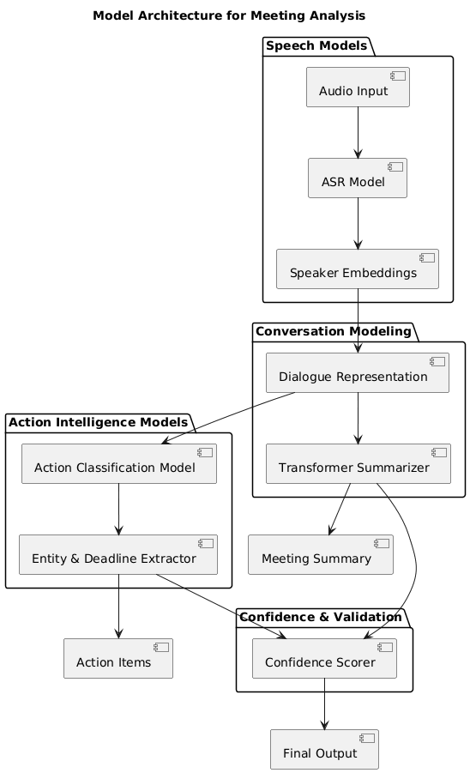
Proposed System Architecture
Description:
The core architecture integrates multiple machine learning models addressing distinct stages of meeting analysis. Automatic speech recognition models convert audio input into textual transcripts, while speaker identification models preserve conversational context. Transformer-based natural language processing models are employed for summarization and semantic understanding. In addition, a supervised action extraction model identifies tasks, decisions, responsible participants, and deadlines from meeting transcripts. Each component operates independently yet contributes to a unified end-to-end pipeline.

Slide 8
Methodology & Implementation Plan
Methodology: We are following an Agile development methodology for the Meeting Summarizer project, enabling iterative progress, continuous feedback, and rapid adaptation to requirements.
Key Development Steps:
1. Requirements Analysis: Gather functional and technical requirements for transcription accuracy, summarization quality, action extraction, multilingual support, and privacy features.
2. Sprint-Based Module Development: Develop each system component in iterative sprints—starting with speech-to-text integration, followed by speaker identification, NLP pipeline, summarization engine, and action extraction module.
3. Dataset Preparation & Annotation: Collect and annotate meeting datasets with transcripts, speaker labels, action items, decisions, and deadlines for model training and evaluation.
4. Model Training & Validation: Train transformer-based models using an 80:20 train-test split, evaluating performance with WER, ROUGE scores, and precision-recall metrics.
5. Integration & Testing: Integrate all modules into a unified pipeline and conduct unit, integration, and system testing to ensure seamless end-to-end functionality.
6. User Feedback & Refinement: Deploy prototypes for user testing, gather feedback, and refine models and interfaces through subsequent sprints.
7. Deployment & Documentation: Package the system with deployment options (cloud/local) and deliver comprehensive technical documentation.

Slide 9
Technology Stack & Tools
Software:
Programming Language: Python Machine Learning / NLP Libraries: TensorFlow, PyTorch, Transformers , NLTK Speech Processing: Whisper, SpeechRecognition APIs Backend Development: Python (Flask) Frontend Development: HTML, CSS, JavaScript Version Control: Git
Tools:
IDE: Visual Studio Code; Cursor API Testing: Postman Model Training & Evaluation: Google Colab Project Management: GitHub

Slide 10
Expected Outcomes & Deliverables
Expected Outcomes:
Accurate speech-to-text transcription of meeting audio
Clear and concise AI-generated meeting summaries
Automatic extraction of action items and decisions
Identification of responsible participants and deadlines
Structured action plan generation
Reduced cognitive load and manual note-taking effort
Improved accountability and execution efficiency
Deliverables
Functional Meeting Summarizer System (Prototype)
Trained models for Transcription, Summarization & Action Extraction
Structured Action Plan Output Format
User Interface for viewing summaries and tasks
Dataset preparation and annotated training data
IEEE Conference Research Paper Documentation

Slide 11
Progress & Milestones Achieved (For Review-1)
Completed Tasks:
System architecture designed
Video & transcript upload implemented Speech-to-text using Whisper integrated Extractive & Transformer summarization developed Action item, person & deadline detection completed Dashboard UI and PDF report generation implemented
Milestones Reached:
End-to-end system integration completed Successful summary generation from real meeting data Automatic action tracking working Web application fully functional
Current Status:
Project implementation completed System under final testing and optimization Preparing for deployment and documentation

Slide 12
Future Work & Next Steps
Planned Activities:
Deploy system on cloud platform (Render/AWS) Optimize model performance and response time Add real-time meeting summarization feature Implement multi-language support Enhance action item tracking with notifications Improve UI with analytics dashboard
Timeline for Next Steps:
Week 1–2: Cloud deployment & testing Week 3: Performance optimization Week 4: Add real-time & multi-language features Final Week: Final testing, documentation & presentation preparation

Slide 13
Publication Status

Slide 14
References(as per IEEE format only)
[1] D. Wang and Y. Liu, “Automatic Meeting Summarization: A Survey,” IEEE/ACM Transactions on Audio, Speech, and Language Processing, vol. 29, pp. 181–197, 2021.
[2] J. Carletta, “Unleashing the Killer Corpus: Experiences in Creating the Multimodal AMI Meeting Corpus,” Language Resources and Evaluation, vol. 41, no. 2, pp. 181–190, 2007.
[3] A. Janin et al., “The ICSI Meeting Corpus,” in Proc. IEEE International Conference on Acoustics, Speech, and Signal Processing (ICASSP), Hong Kong, 2003, pp. 364–367.
[4] J. Xie, B. Liu, and J. Huang, “Abstractive Meeting Summarization Using Hierarchical Transformer Models,” arXiv preprint arXiv:2004.00000, 2020.
[5] Y. Liu and M. Lapata, “Text Summarization with Pretrained Encoders,” in Proc. Conference on Empirical Methods in Natural Language Processing (EMNLP-IJCNLP), Hong Kong, 2019, pp. 3721–3731.
[6] J. Devlin, M.-W. Chang, K. Lee, and K. Toutanova, “BERT: Pre-training of Deep Bidirectional Transformers for Language Understanding,” in Proc. NAACL-HLT, Minneapolis, MN, USA, 2019, pp. 4171–4186.
[7] C. Raffel et al., “Exploring the Limits of Transfer Learning with a Unified Text-to-Text Transformer,” Journal of Machine Learning Research, vol. 21, no. 140, pp. 1–67, 2020.

Slide 15
THANK YOU!

